Slide 1
Interconnecting LANs
Connecting multiple LANs
  Repeaters
  Bridges
Notes:
In this lecture we consider the problem of extending networks and connecting networks of different types together.
We will discuss the use of repeaters to extend physical length and of bridges to connect LANs with different protocols such as connecting Ethernet to a Token network.

Slide 2
Repeaters
Used to connect LANs running the same protocol
cleans up signals
  receives, amplifies, re-transmits
Cannot extend total system length beyond N=2LB/v limit
Notes:
Repeaters are basically simple devices which do not perform any active function at the protocol level.
They are used to connect two LANs running the same protocol, for example two Ethernets. They consist of a receiver and a transmitter which relays the packets on one side of the repeater to the other side.
They are useful for extending the length of a LAN where losses would otherwise prevent the signals from being useful. They cannot circumvent the overall limit on the system length specified in the relevant standard.

Slide 3
Bridges
Operate within the data link layer
  do not examine network layer headers
  can deal with IP, IPX, OSI etc packets
Translate between various MAC sublayers
  e.g. 802.3 to 802.4
Applications
  necessity, limitations, demand
  isolation, security
Notes:
Although bridges are a much more sophisticated network element than repeaters they do not implement the full OSI protocol stack. They only deal with the data link and physical layers.
Since they have no knowledge of the network layer they cannot distinguish between IP and IPX packets for example. So they can transfer packets from one network to another provided they speak the appropriate data link protocol on the networks they join.
The reason they need to have a knowledge of the data link protocols is that the frame structure is dependent on the protocol and therefore the bridge will have to re-construct the header into the appropriate format.
There are several reasons why we might need bridges:
We can’t guarantee that two parts of the same organisation installing LANs will make the same choice for network infrastructure, especially as they may have different requirements for the LAN.
Bridges provide a way of getting round the limitations imposed by individual LANs such as the maximum length.
It might be the case that the total user population represents has a bandwidth requirement that cannot be satisfied by a single LAN
Bridges perform a kind of isolation so that if a LAN goes down, the other LANs to which it is bridged can still operate.
Bridges can provide some degree of security without the need for physical isolation.

Slide 4
Simple bridge application
Bridge
Bridge
Bridge
Token Ring
Ethernet
Notes:
This diagram shows a simple application of bridges in which local LANs are connected to a backbone LAN. Each bridge may know about many protocols but it must know about the protocol of the backbone LAN (which may be different to all the others) and the protocol of the local LAN it is serving.
Note in this example, a bridge is connected to a token ring and so it must be capable of holding the token. On the Ethernet it sits as a terminal peered with all the others and has to fight for bandwidth. Since the bridge cannot guarantee immediate access to the shared access medium it must have some buffers to enable it to store packets as they arrive off the backbone LAN.

Slide 5
Bridge Problems
Re-framing
Preamble
Start delimiter
Access control
Frame control
Addresses
Length
Data
Pad
Checksum
End delimiter
Frame status
802.3
802.4
802.5
Notes:
The basic problem to solve in a bridge is to do with re-framing. However, while this may sound like a simple reordering of bytes or just leaving out the ones that aren’t there, remember that different MAC protocols have different functions and different definitions of some of the frame fields. For example:
All three of the 802 LANs shown here have different maximum frame lengths. If a frame arrives at a bridge which is too large for the intended LAN there is nothing that can be done since the data link layer does not provide the capability of splitting and recombining frames. We are dead.
There are nine possible LAN bridges required to cover the three standard IEEE 802 LANs shown in the diagram. Here are a few specific problems:
Token management does not exist on Ethernets. A feature included in 802.4, known as temporary token handoff, allows the token holder to temporarily give the token to the destination so that an ack frame can be sent. This process is handled by a field that does not exist in an Ethernet frame so if two 802.4 networks are bridged by an Ethernet this facility fails.
Token networks also have the concept of priority which Ethernets don’t so when going from Ethernet to a token network some guess has to be made about priority.
More details can be found in figure 4-37 of Tannenbaum, reproduced on the next slide.

Slide 6
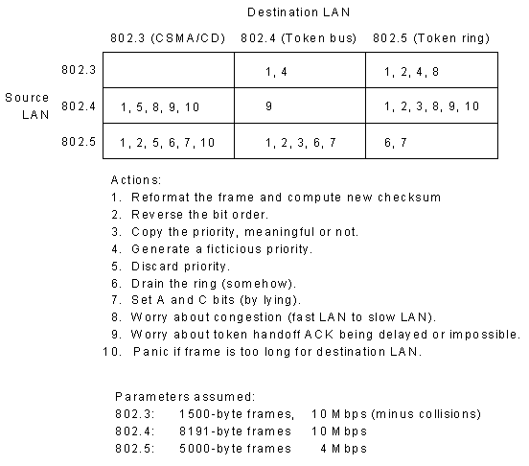
IEEE 802 Bridges
Notes:
In this diagram (from Tanenbaum, 4.37) a whole range of problems associated with bridging between two LANs are described.

Slide 7
Transparent Bridges
J
L
Bridge
Bridge
K
M
I
Routing tables
  use backward learning
Looped paths
  use spanning tree
E
A
Token Ring
H
D
G
B
F
C
Ethernet
Notes:
Here we see part of a network with three LANs connected via a backbone. If every frame on the network was simple replicated then there would be a huge amount of wasted traffic. For example, all the traffic internal to the Token ring would be needlessly duplicated on the two Ethernets. In order to avoid this the bridges use routing tables to enable them to decide if a packet needs to be sent to a particular LAN.
To make the bridges ‘plug and play’ they construct the routing tables for themselves using an algorithm called backward learning. The bridge monitors each of the LANs it is physically connected to and makes a note of the source address of every packet it sees on each LAN. Consider the bridge connected to the token ring network, every packet it takes off that network must have come from stations connected to it, so it can list all of their source addresses as belonging to the token ring (A-E). Similarly, all of the Ethernet frames that come in from the second bridge have source addresses that belong to that LAN (F-M), note that as far as the first bridge is concerned the pair of Ethernets (F-I and (J-M) look like a single Ethernet.
If the bridges do not know the destination for a particular address (either because the table entry has not been generated or because an old entry has been deleted as possibly out of date) then they resort to flooding the LANs.

Slide 8
Spanning Trees
Bridge
Bridge
Loops can occur
  construct a logical connection between the bridges which avoids loops
I
A
H
B
G
C
F
D
Bridge
Bridge
Notes:
In the example shown here, two bridges connect the same pair of Ethernets. This might be done to provide some resilience to the network. However, if flood routing has to be used we have the possibility of frames being duplicated and circulated forever.
To avoid this happening, the bridges communicate amongst themselves to construct a logical network on top of the physical network
This would result in the virtual elimination of one of the bridge links in this case. For example the logical network might look like....

Slide 9
Spanning Trees
Bridge
Bridge
Loops can occur
  construct a logical connection between the bridges which avoids loops
I
A
H
B
G
C
F
D
Bridge
Bridge
Notes:
this. The loop has now been removed by pretending the top link does not exist. Of course, in the event of a failure of the bottom link the network could be restored by reconstructing the spanning tree.
A spanning tree consists of the set of nodes with sufficient links to connect all the nodes without inducing a loop in the system. One way of constructing the spanning tree is as follows: Take each link in turn, does removing this link leave the network fully connected? If it does, remove the link and start again. If not replace the link and move on to the next link.

Slide 10
Next Lecture
Network Layer
  Relation to the Transport layer
  Routing
    static
    dynamic
    algorithms
Notes:
This concludes our study of the data link layer. In the next lecture we will start looking at the network layer. This is the highest layer that exists in network based routers and is mainly responsible for ensuring that packets get from the source to the destination.
We begin by looking at the relationship with the transport layer and the services it supplies to that layer.
We will then look at the problems of routing on a network and see how the paths are built up. We will also look at the way the network responds to problems such as router crashes, link failure and topology changes.

